Slide 1


DRIVEN BY DATA : UNVEILING THE
ROADMAP FOR PURCHASING
A DREAM CAR
BY SACHIN THAKUR

Slide 2

PLAN to get it
SET UP BUDGET : Discuss which car and how much can you afford to spend on a car? This will help you narrow down your choices and focus on cars that are within price range.
KEEP A NOTE OF factors like budget, preferred models fuel consumption, and keen features and safety ratings.
Will uncover the power of data in making informed choices . Let’s dive in …..

Slide 3

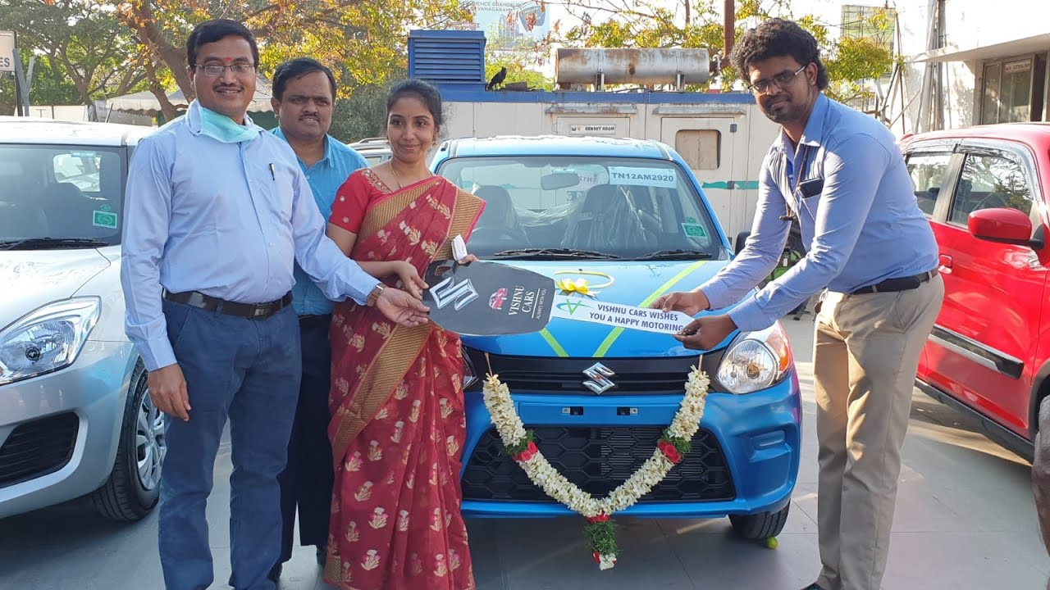
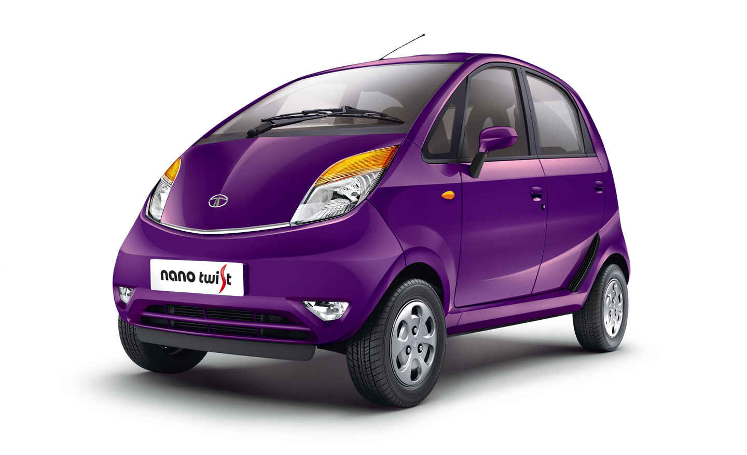

Prepare
Determine your needs : What do you need a car for? Will you be using it for commuting, road trips, or both? How many people will be regularly using the car? Once you know your needs, you can start to look for cars that have the features you require.
Do your research : Read reviews, compare prices, and test drive different cars before you make a decision. It's also a good idea to talk to friends, family, and colleagues who own cars to get their recommendations.
Consider your lifestyle. If you have a family, you'll need a car that's big enough to fit everyone and their belongings. If you live in a city, you might want to consider a smaller car that's easier to park.

Slide 4


PROCESS
Consider your financing options : If you can't afford to pay for a car in cash, you'll need to finance it. There are a number of different financing options available, so it's important to compare rates and terms before you choose one.
Get pre-approved for a loan : This will give you an idea of how much you can borrow and what your monthly payments will be. It will also make the car buying process go more smoothly.
Carry the required documents : to the dealership for buying a new car like AADHAR , DRIVING LICENSE , PAN CARD AND all other essential certificates .

Slide 5
Analyze
Shop around : Don't just go to one dealership. Compare prices from different dealerships to get the best deal.
Don't be afraid to negotiate : The sticker price is just a starting point. Don't be afraid to negotiate with the dealer to get a lower price.
Reliability : How reliable is the car you're considering? You can research car reliability ratings online or talk to friends and family who own the same car.
Fuel efficiency: How fuel-efficient is the car you're considering? If you have a long commute or drive frequently, fuel efficiency is an important factor to consider.
Safety: How safe is the car you're considering ? Look for cars that have good safety ratings from the National Highway Traffic Safety Administration (NHTSA) and the Insurance Institute for Highway Safety (IIHS).

Slide 6
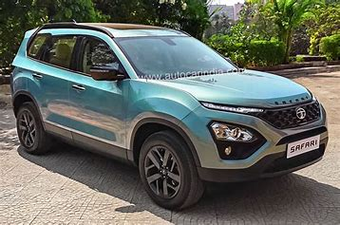
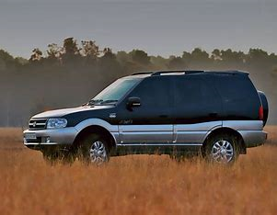
share
Giving the best sort explanation about the research we have done to dealer that may be helpful for him to give the best sort of opinion on the car we have chosen .
Taking the other opinion’s like google the specifications of the car from online , visiting various dealership’s , from friends and family etc.
Check the which variant of car u want buy ,which is the auspicious date who want to get Ur car delivered from which showroom and where are u going to plan Ur first ride from Ur brand new car .

Slide 7

ACT
Read the contract carefully before you sign it : Make sure you understand all the terms and conditions before you commit to buying the car.
Warranty : What kind of warranty does the car you're considering have? A good warranty can protect you from unexpected repairs down the road.
Get the car checked out by a mechanic : Even if you're buying a new car, it's a good idea to get it checked out by a mechanic before you drive it off the lot. This will help you identify any potential problems.
Enjoy your new car! Congratulations on your new car. Take some time to get to know it and enjoy driving it.

Slide 8
Conclusion
CONGRATULATIONS ! WE’RE NOW EQUIPPED WITH THE KNOWLEDGE TO MAKE SMART CAR PURCHASE FOR OUR NEEDS DRIVEN BY DATA .
EMBRACE THE POWER OF INFORMATION , STAY INFORMED ABOUT THE CUSTOMER TRENDS AND FOLLOW DATA TO NEGOTIATE THE BEST DEALS .
WITH DATA AS OUR CO-PIOLT , WE’RE READY TO HIT THE ROAD AND MAKE CONFIDENT DECISIONS ON OUR JOURNEY TO FINDING THE NEW
CAR….

Slide 9
THANK YOU
THAKUR SACHIN SINGH
E-mail : tsachinsingh847@gmail.com

